Slide 1

CS654: Digital Image Analysis
Lecture 29: Color Image Processing

Slide 2
Recap of Lecture 28
Interactive image segmentation
Graph based approach
Segmentation using Eigen analysis (Normalized cut)
Graph cut

Slide 3
Outline of Lecture 29
Color image processing
Fundamentals of colors
Primary and secondary colors (light and pigment)
Color models

Slide 4
Motivation
Color is a powerful descriptor that often simplifies object identification and extraction from a scene.
Human can discern thousands of color shades and intensities, compared to about only two dozen shades of gray.

Slide 5
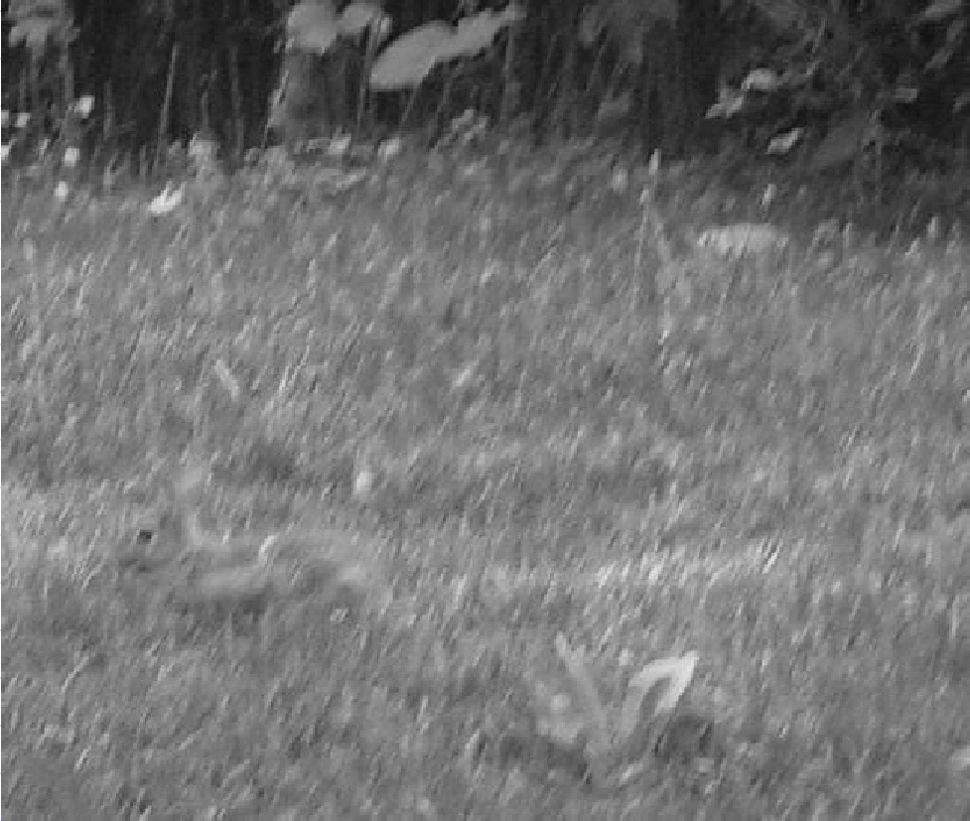
Illustration

Slide 6
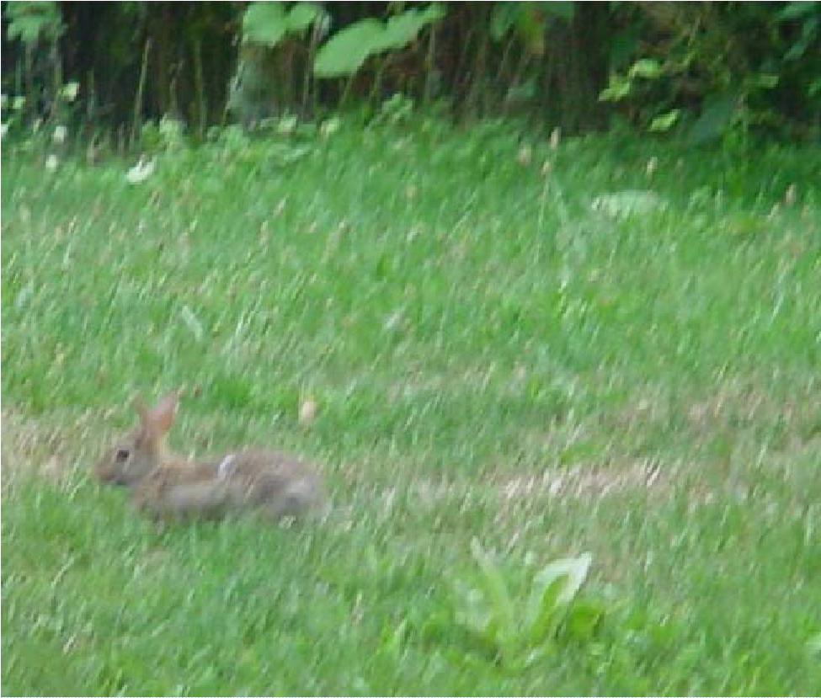
Illustration

Slide 7
Color image processing
Full color images
Pseudo color images

Slide 8
Color Fundamentals
Images: Gonzalez & Woods, 3rd edition
The experiment of Sir Isaac Newton, in 1666.

Slide 9
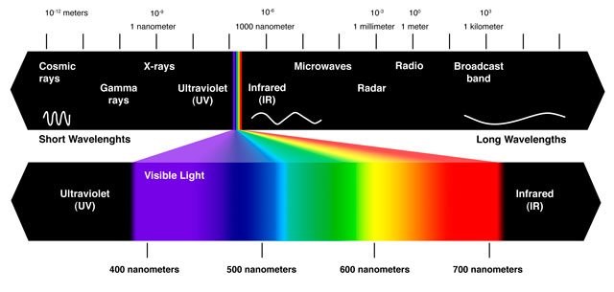
Color Fundamentals
White Light
Colours Absorbed
Green Light

Slide 10
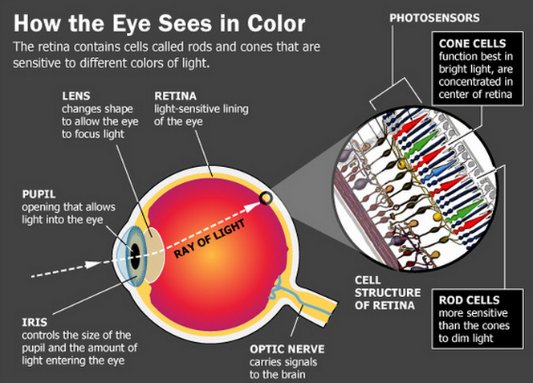
Human perception of colors
Image courtesy: http://www.livescience.com
Sensitivity of CONE cells
66% to red
33% to green
6% to blue

Slide 11
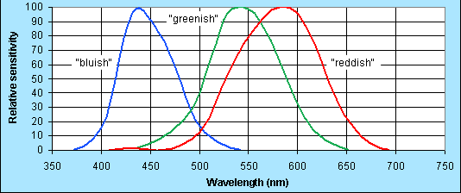
Probable Human Eye Cones Sensitivities
Image courtesy: http://www.graphics.com
Standard wavelength values for the primary colors

Slide 12
How is the neural signal physically generated?
The retina contains millions of specialized photoreceptor cells known as rods and cones.
Within these receptors are membranes with visual pigments
Pigments consist of retinene joined at both ends to retinal proteins called opsins
These three types of cone opsins account for the differences in peak wavelength absorption for each pigment.

Slide 13
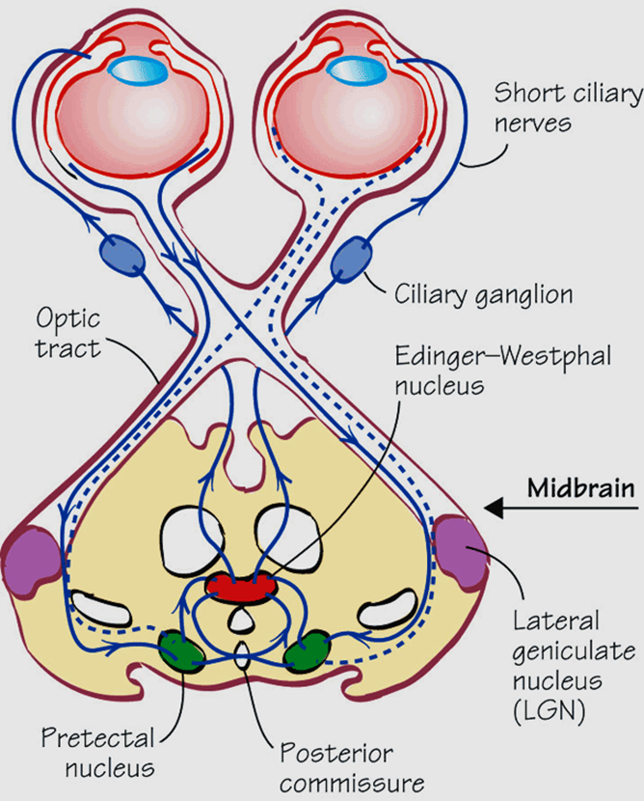
Retinoptic organization
Image courtesy: www.pinterest.com

Slide 14
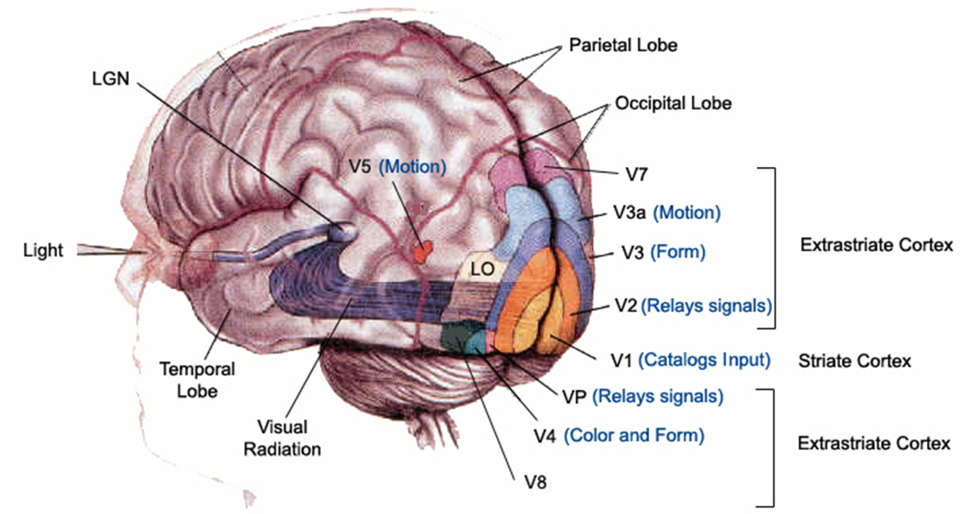
Visual brain
Image courtesy: http://neuronresearch.net
Characterized by a set of parallel processing perceptual systems, and a temporal hierarchy in visual perception
The eye alone does not tell the story

Slide 15
Color Fundamentals
Basic quantities to describe the quality of light source:
Radiance: Total amount of energy that flows from the light source (in W).
Luminance: A measure of the amount of energy an observer perceives from the light source (in lm)
Brightness: A subjective descriptor that embodies the achromatic notion of intensity and is practical impossible to measure.

Slide 16
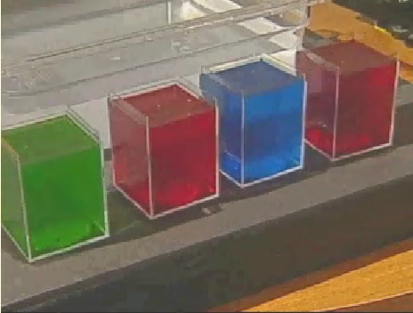
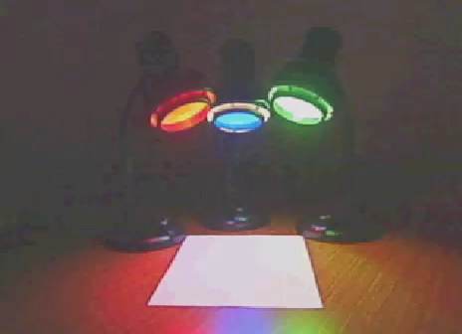
Light and Pigments
Primary colors (Light)
Mixing of chromatic lights
Mixing of pigments

Slide 17
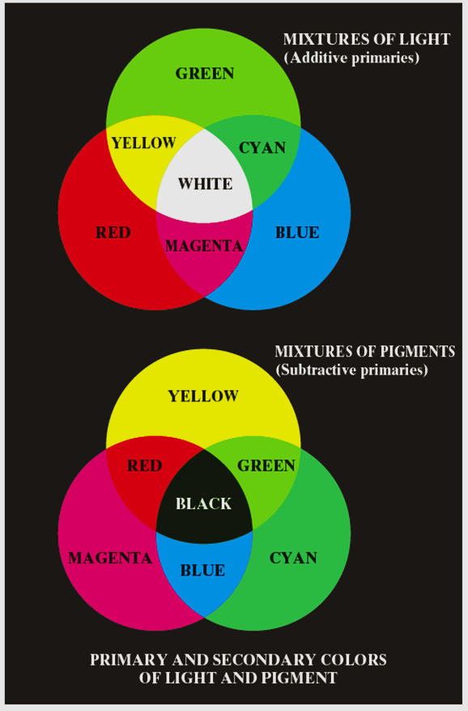
Primary colors
Images: Gonzalez & Woods, 3rd edition

Slide 18
Color Fundamentals (con’t)
The characteristics generally used to distinguish one color from another are Brightness, Hue, and Saturation.
Hue: Represents dominant color as perceive by an observer.
Saturation: Relative purity or the amount of white light mixed with a hue
Hue and saturation taken together are called Chromaticity
A color may be characterized by its Brightness and Chromaticity

Slide 19
Color Fundamentals (con’t)
Tri-stimulus values: The amount of Red, Green and Blue needed to form any particular color
Denoted by: X, Y and Z
Tri-chromatic coefficient:

Slide 20
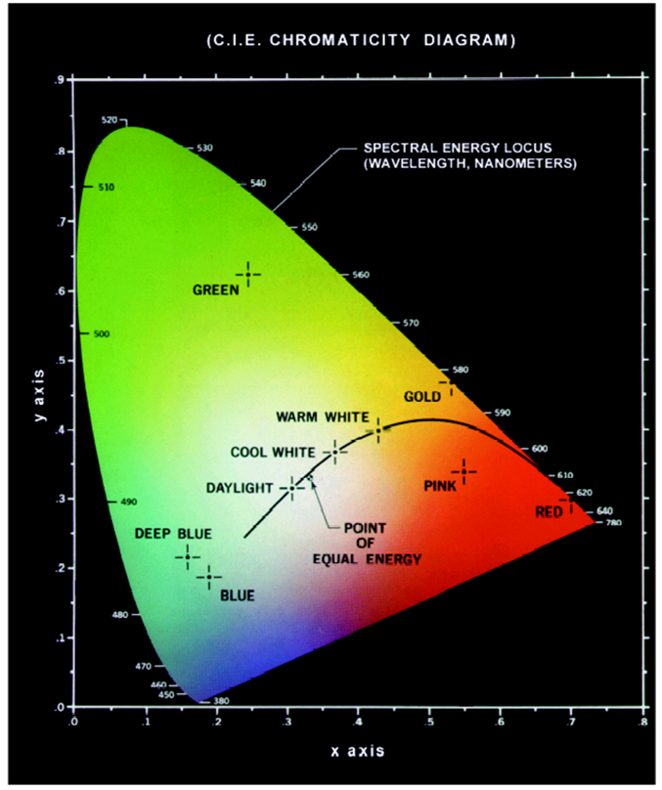
Chromaticity Diagram
Images: Gonzalez & Woods, 3rd edition
Green Point =
62% green,
25% red,
13% blue.

Slide 21
Color Fundamentals (con’t)
Images: Gonzalez & Woods, 3rd edition
Color Gamut produced by RGB monitors
Color Gamut produced by high quality color printing device

Slide 22
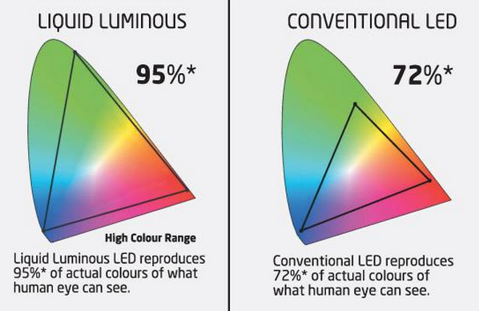
Advertisement !!
* As per NTSC standards of what human eye can see

Slide 23
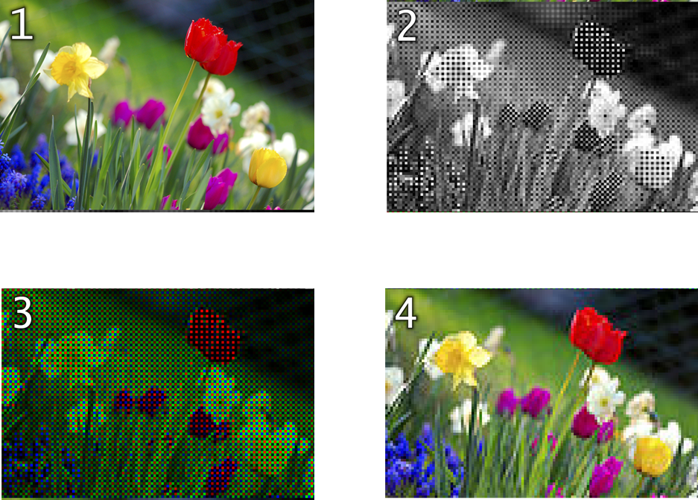
Digital camera
Images: Wikipedia

Slide 24
Color Models/ Color space / Color system
Facilitate the specification of colors in some standard, generally accept way.
RGB (red, green, blue) : monitor, camera.
CMY(cyan,magenta,yellow),CMYK (CMY, black) model for color printing.
HSI model, which corresponds closely with the way humans describe and interpret color.

Slide 25
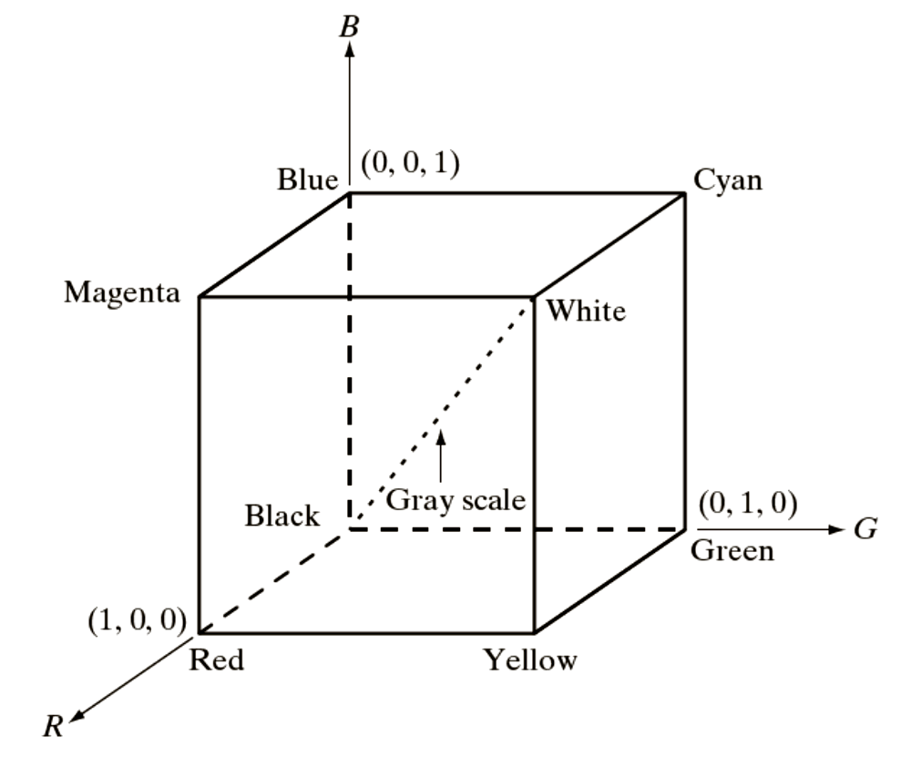
The RGB Color Models (con’t)
Images: Gonzalez & Woods, 3rd edition

Slide 26
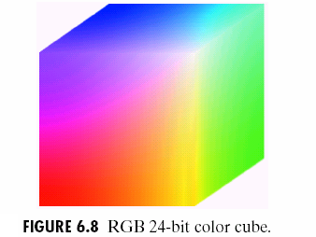
The RGB Color cube
Images: Gonzalez & Woods, 3rd edition
Bit depth

Slide 27
The CMY and CMYK Color Models
Cyan, Magenta and Yellow are the secondary colors of light
Most devices that deposit colored pigments on paper, such as color printers and copiers, require CMY data input.

Slide 28
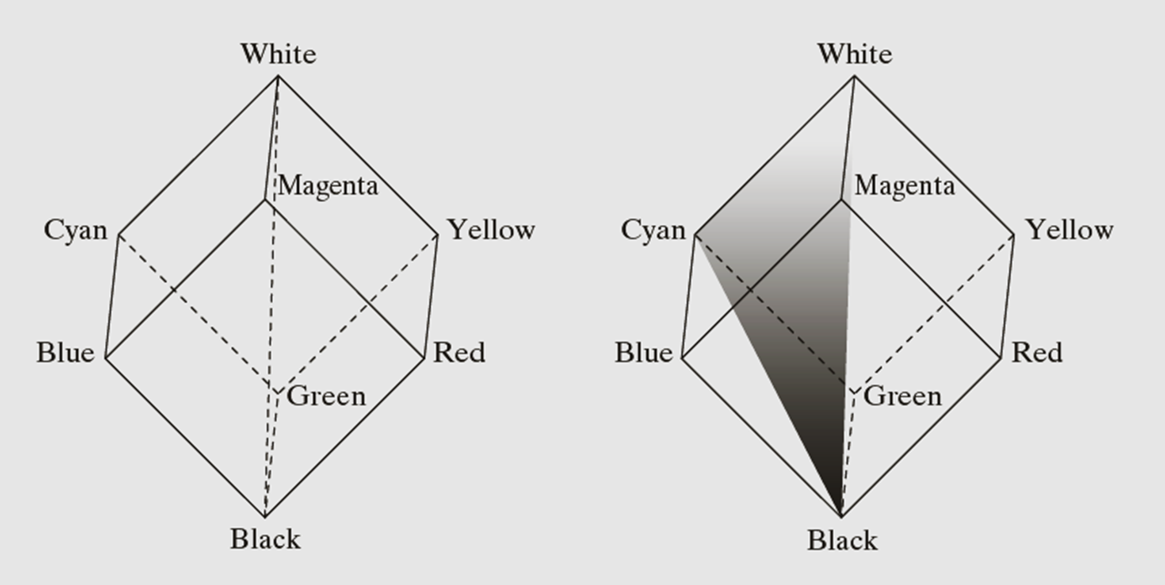
The HSI Color Models
Images: Gonzalez & Woods, 3rd edition

Slide 29
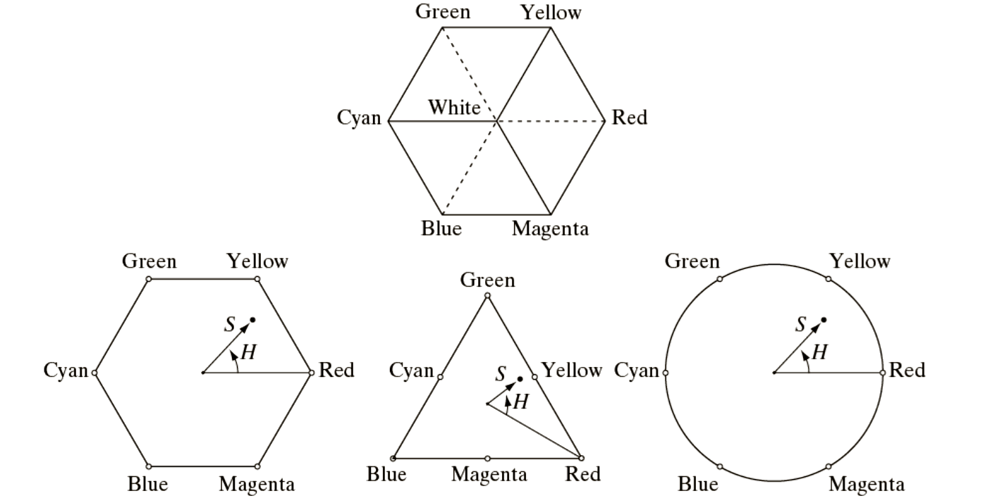
The HSI Color Models

Slide 30
The HSI Color Models

Slide 31
Thank you
Next Lecture: Color Image Processing

